Slide 1
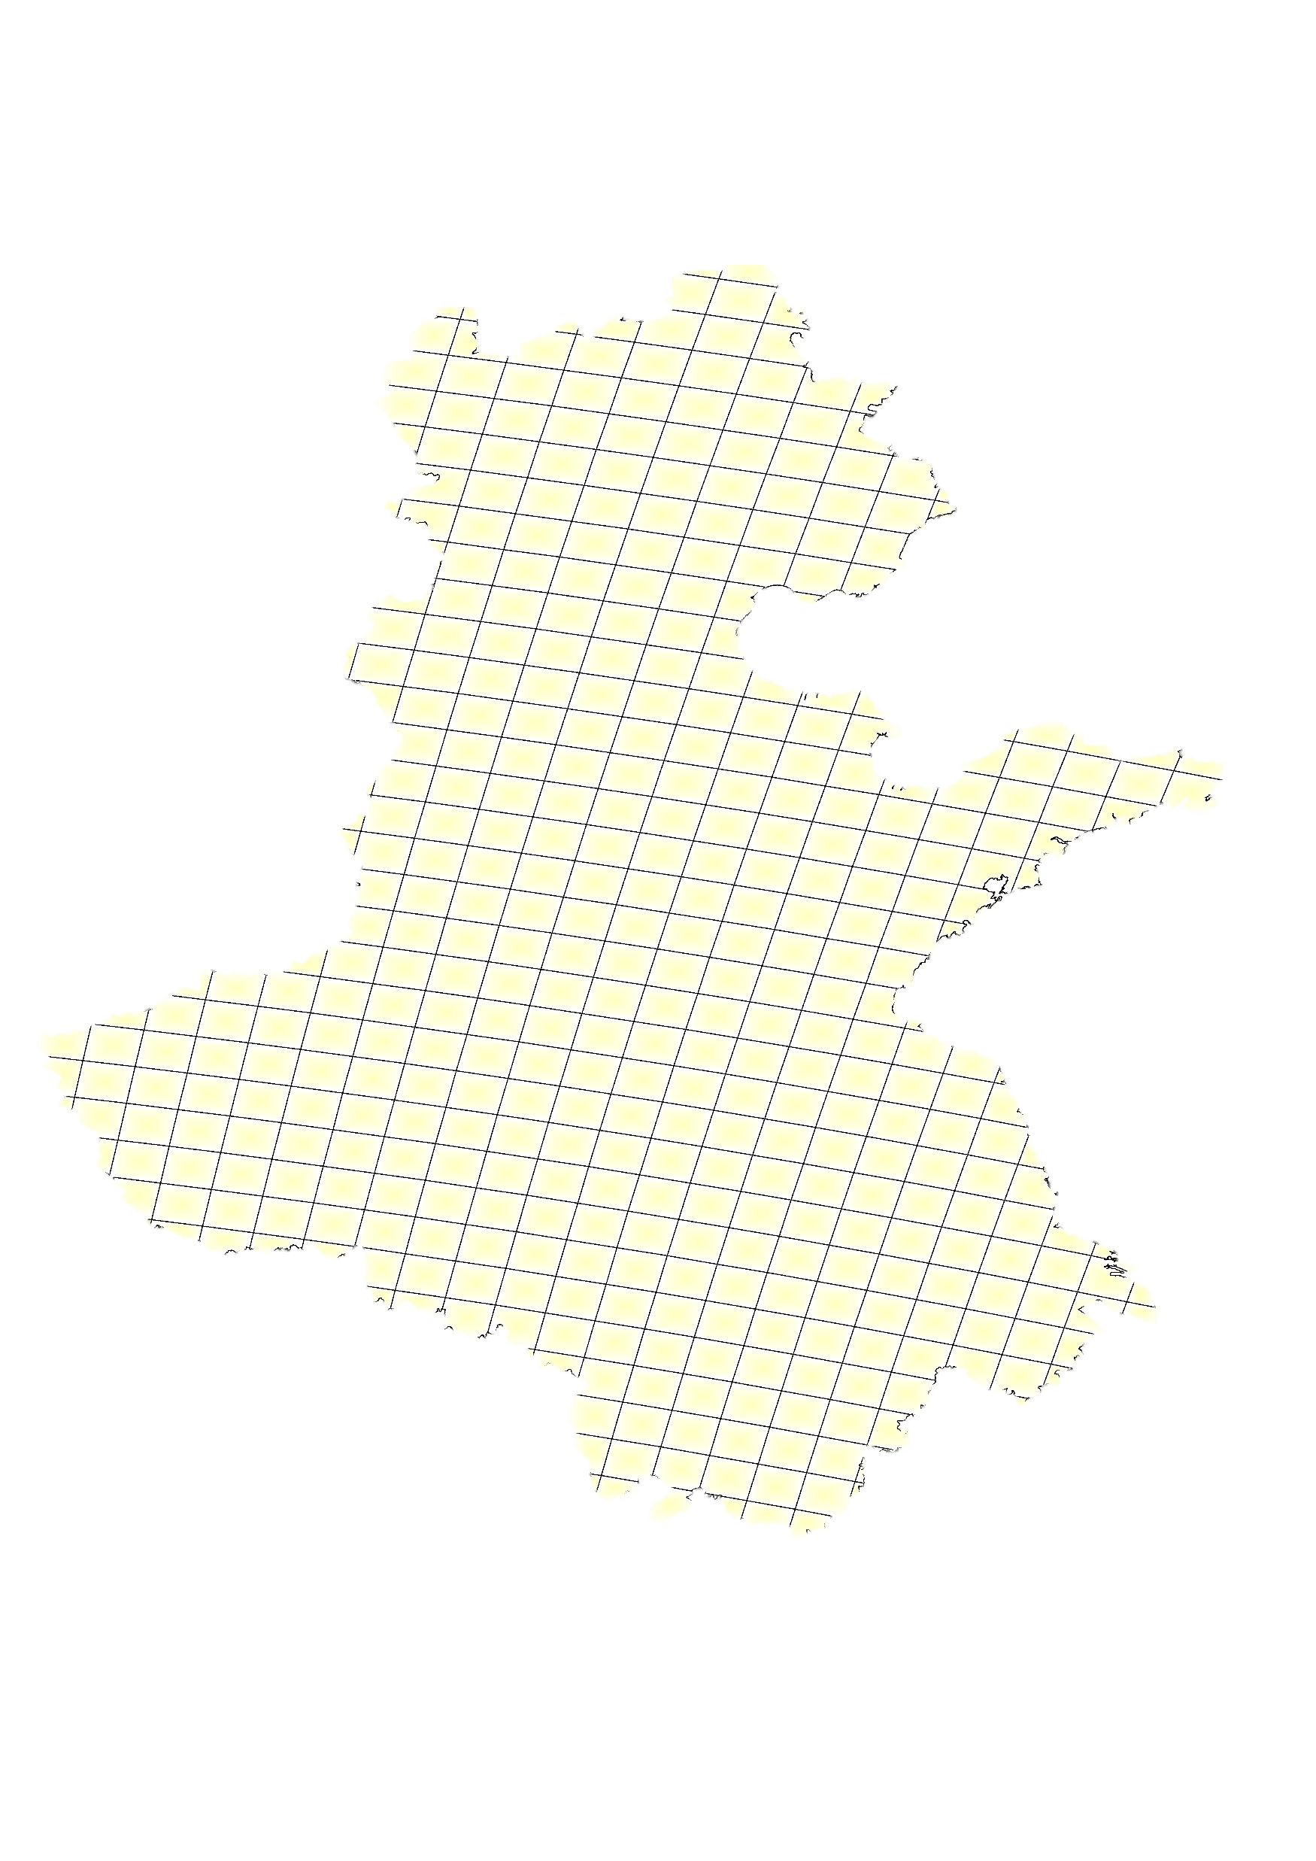
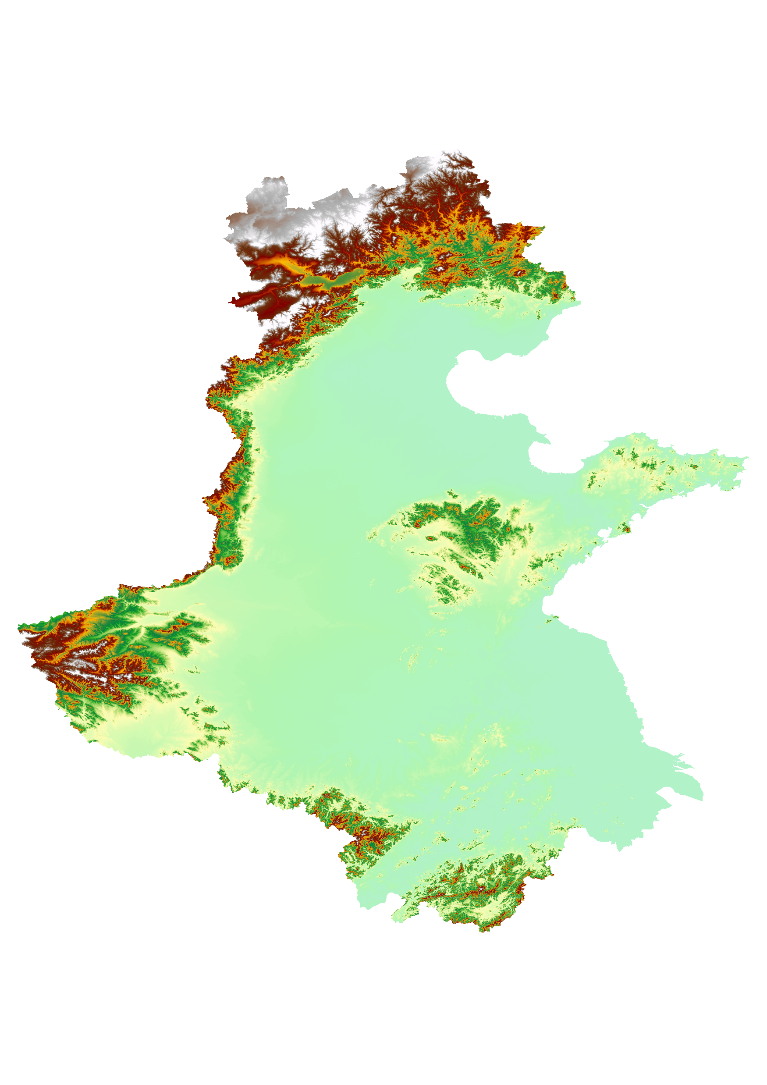
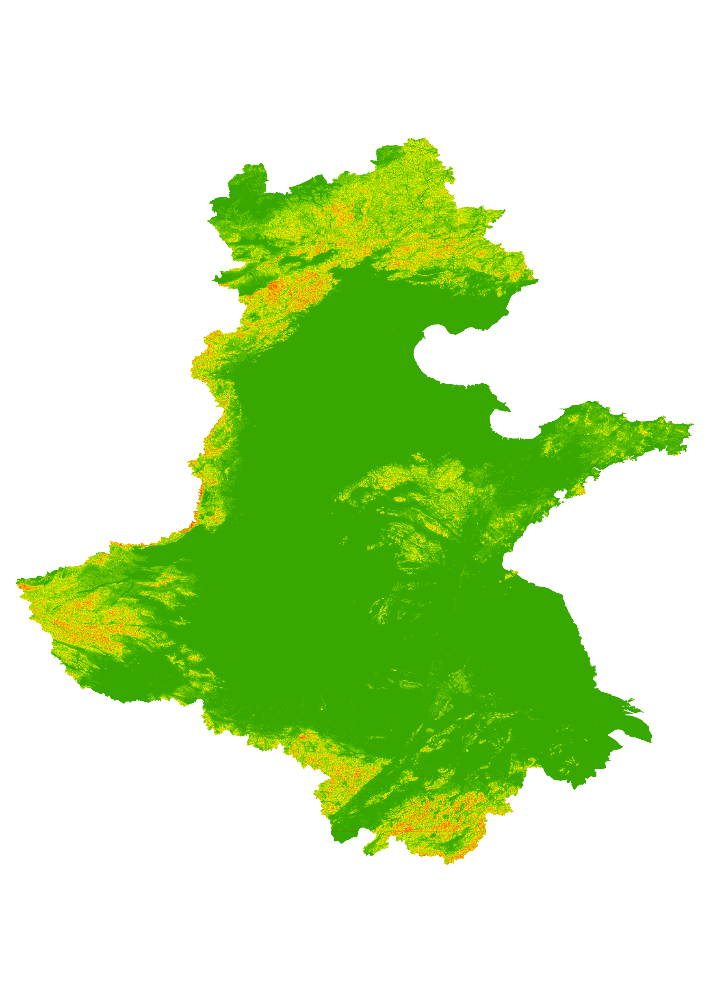
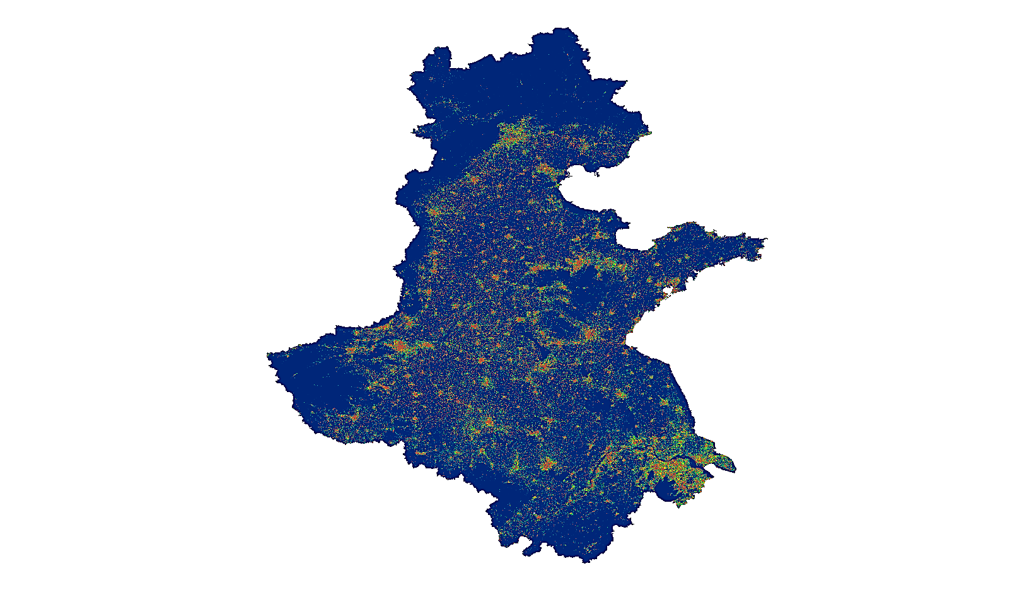

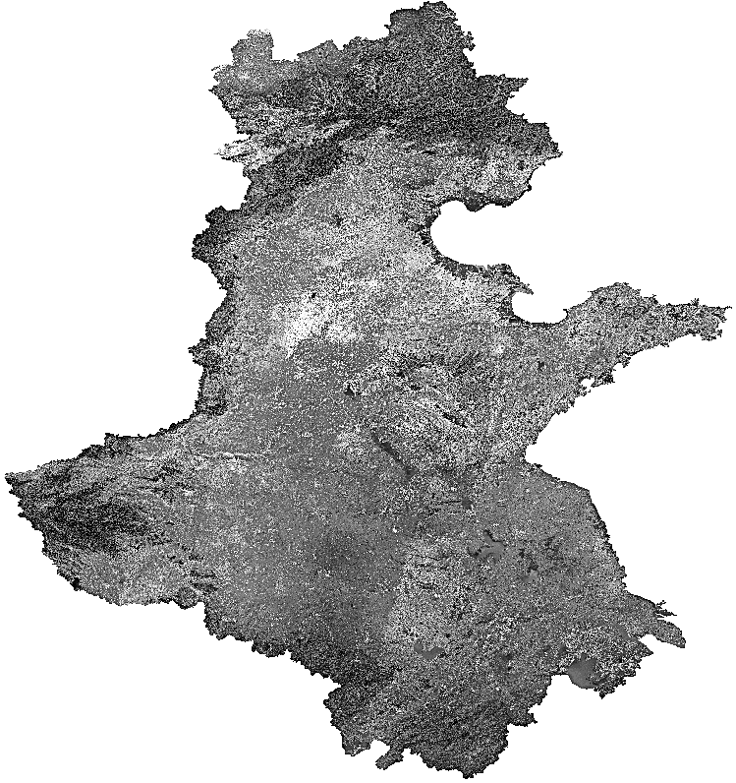
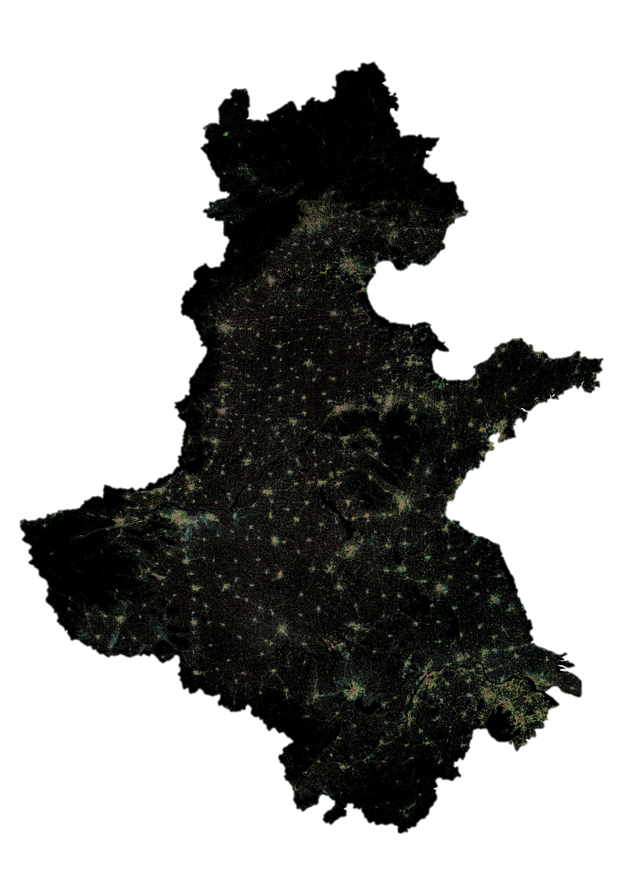
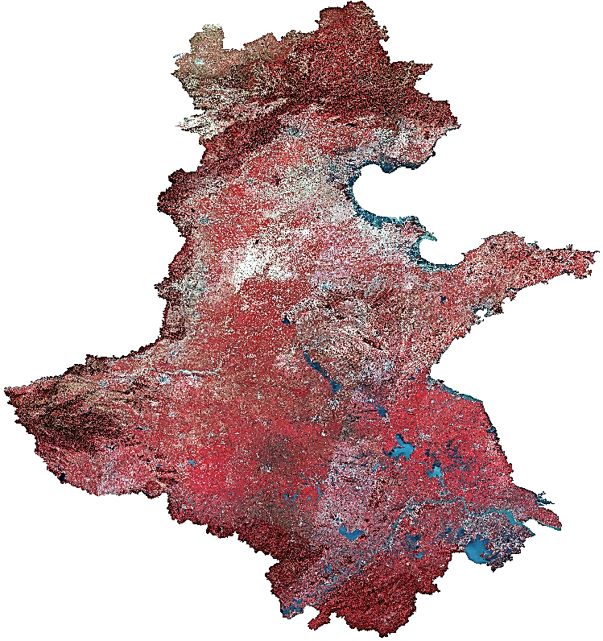
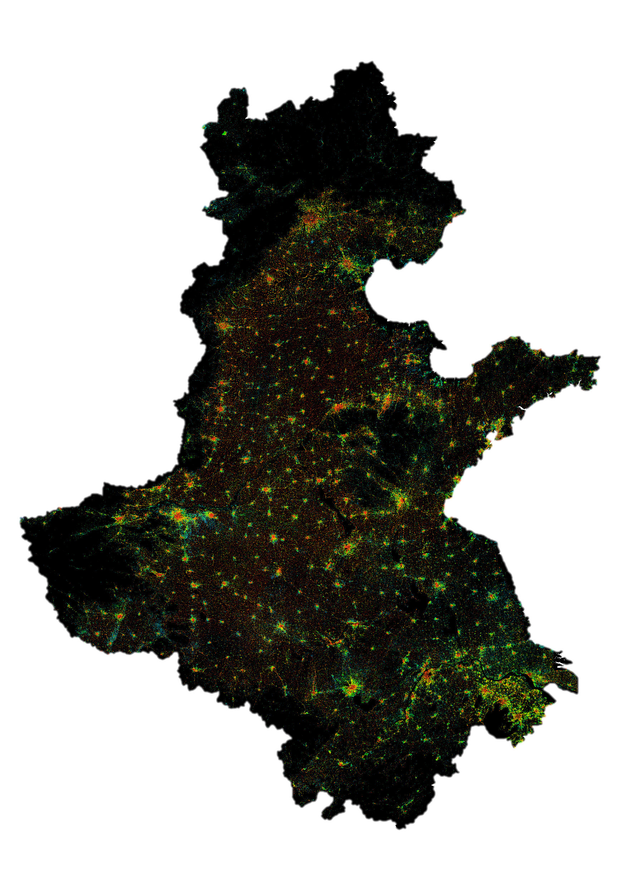
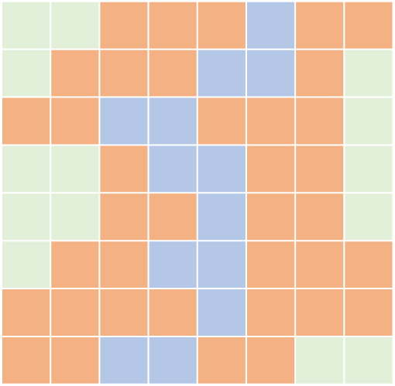
Data preprocessing
Training sample collection
Training parcels
Elevation
Slope
256
256
Random crop
Transition potential
Training
Concatenation
UNET
Landsat archive
Historical urban land-use
Binarization
Projection map
Area extrapolation
Pixel reclassification
1
0
Performance evaluation
True map
Landscape patch
 | Urban | Non-urban
Urban | A | B
Non-urban | C | D
Overall Accuracy
Patch Number
True positive rate
Figure of Merit
AUC
Prediction
Hit Rate
Shape Index
False positive rate

Slide 2
Data preprocessing
Training sample collection
Elevation
Slope
Training parcels
256
256
Random crop
Training
Concatenation
Transition potential
UNET
Landsat archive
Historical urban land-use
Projection map
Binarization
1
0
Performance evaluation
True map
Landscape patch
 | Urban | Non-urban
Urban | A | B
Non-urban | C | D
Overall Accuracy
Patch Number
True positive rate
Figure of Merit
AUC
Prediction
Hit Rate
Shape Index
False positive rate

Slide 3
Data preprocessing
Training sample collection
Elevation
Slope
Training parcels
256
256
Random crop
Training
Concatenation
Transition potential
UNET
Landsat archive
Urban expansion maps
Projection map
Binarization
1
0
Performance evaluation
True map
 | Urban | Non-urban
Urban | A | B
Non-urban | C | D
Overall Accuracy
Map of the projection date
True positive rate
AUC
Prediction
Figure of Merit
Hit Rate
False positive rate

Slide 4
3
32
32
32
32
32
32
1
256 ²
256 ²
64
64
64
64
64
64
128 ²
128 ²
128
128
128
128
128
128
64 ²
64 ²
32 ²
256
256
256
256
256
256
32 ²
Conv 3*3; BatchNorm; ReLU
m
512
512
512
512
Copy
16 ²
512
512
16 ²
Conv 1*1; Softmax
N: Image size
MaxPool 2*2
N ²
8 ²
1024
1024
m: Num. channels
Up-Conv 2*2
Concatenation

Slide 5
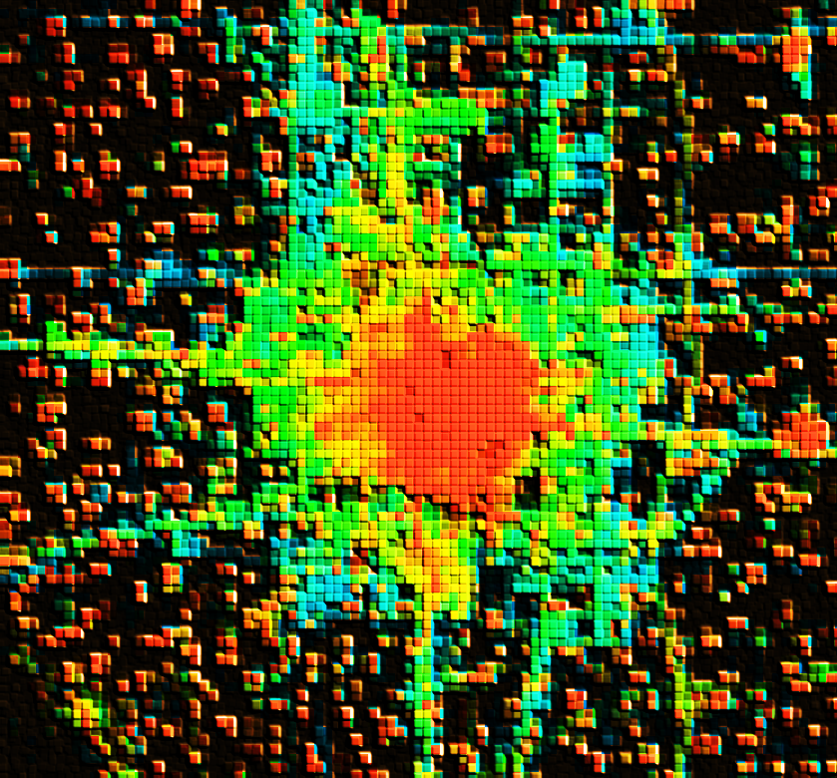
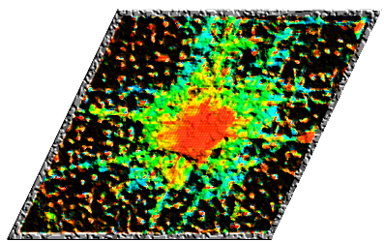
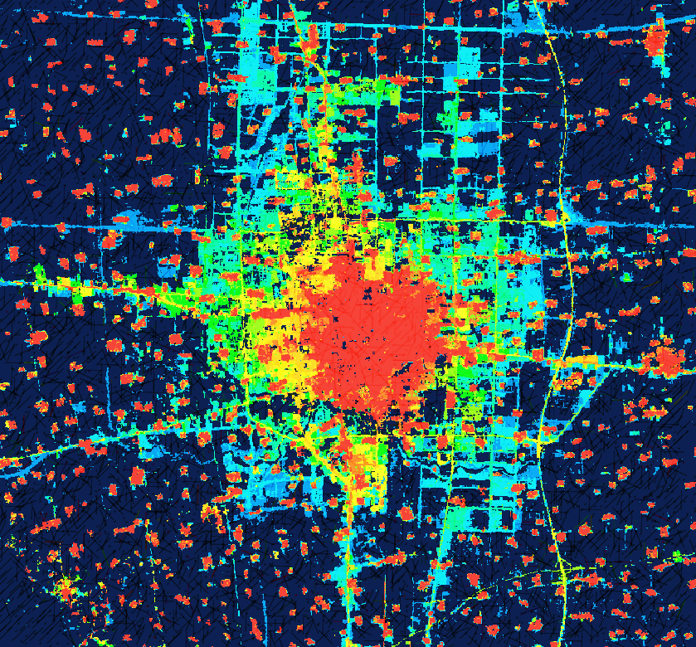
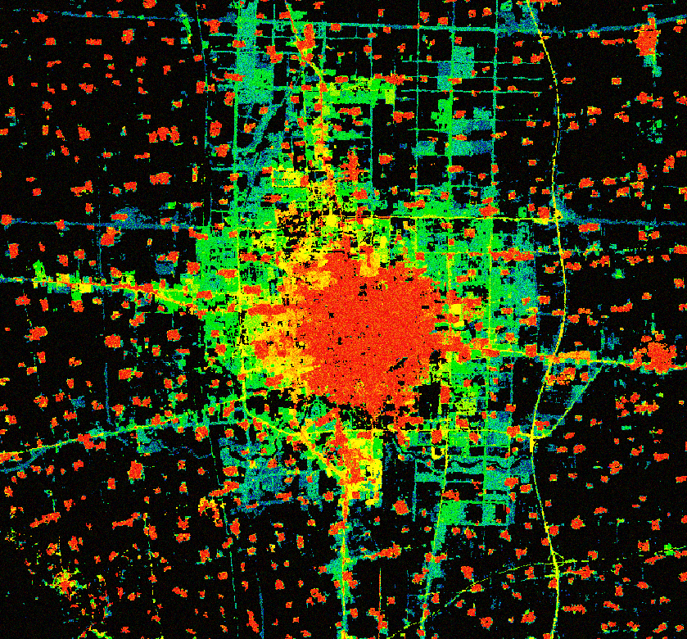
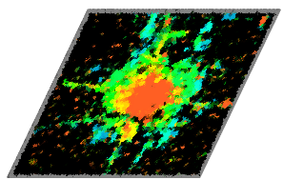
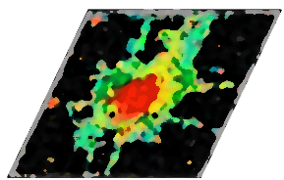
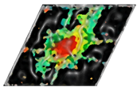
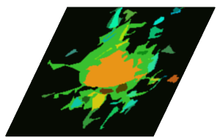
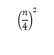
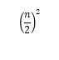
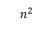
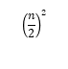
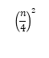
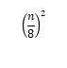
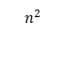
Input map
Prediction map
Reference map
$$n^{2}$$
$$n^{2}$$
$${\left(\frac{n}{2}\right)}^{2}$$
$${\left(\frac{n}{2}\right)}^{2}$$
$${\left(\frac{n}{4}\right)}^{2}$$
Loss
Down sampling
$${\left(\frac{n}{4}\right)}^{2}$$
Up sampling
$${\left(\frac{n}{8}\right)}^{2}$$
Skip connection

Slide 6
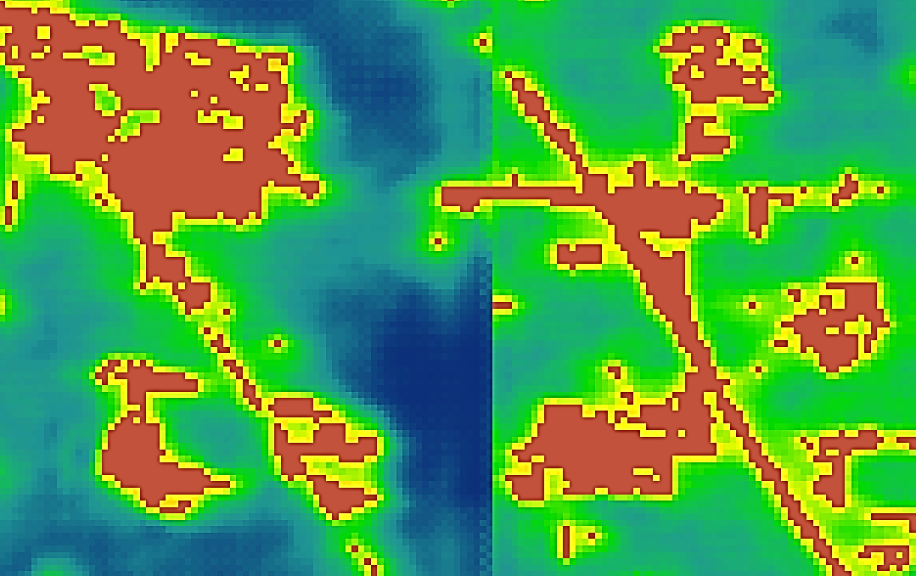
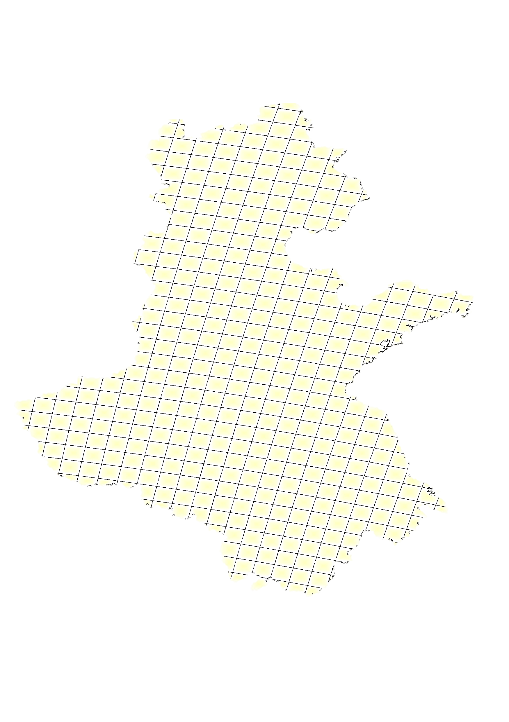
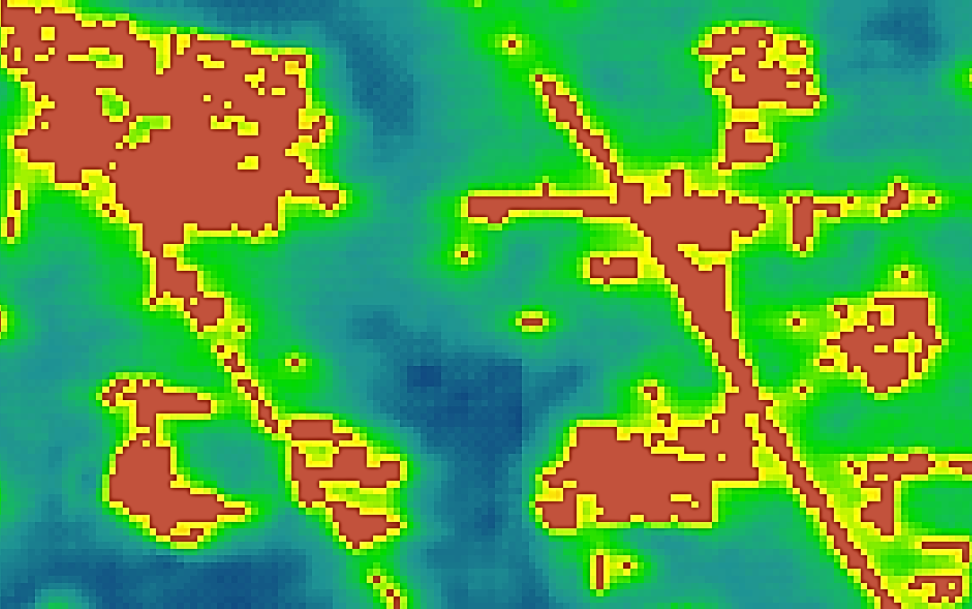
256
No buffer
Mosaic
UNET
Crop
32
Buffer to remove
With buffer
Mosaic
Mosaic

Slide 7
Cubic
Projected urban area
Quadratic
Linear
Historical urban area
1990
2019
2030

Slide 8
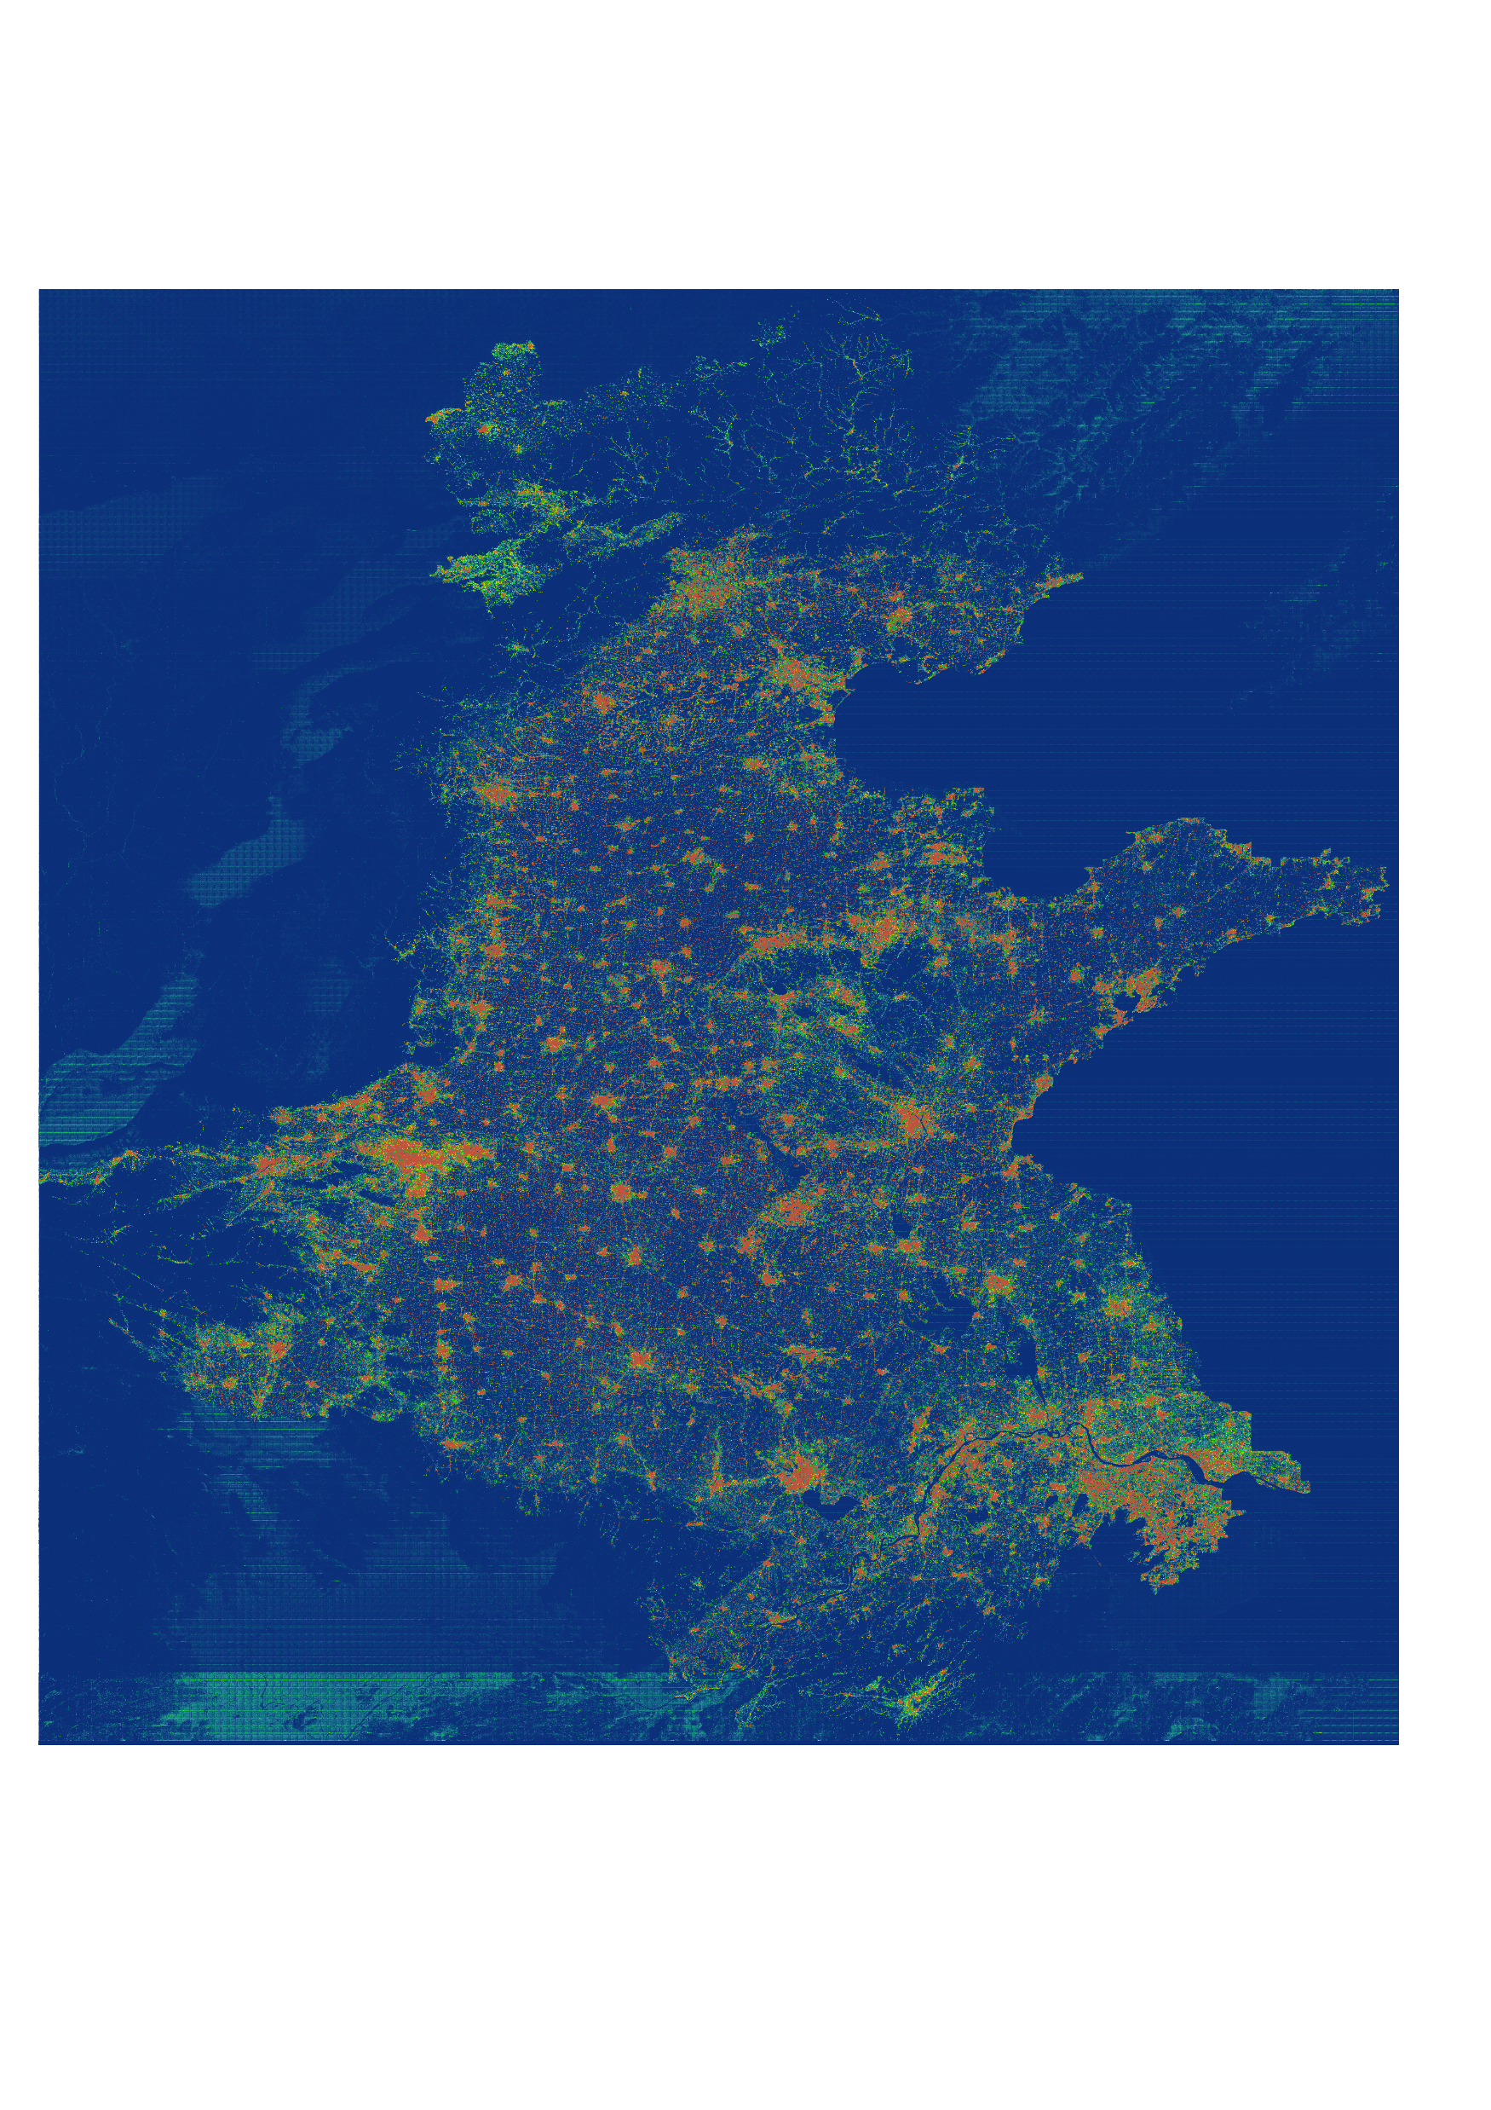
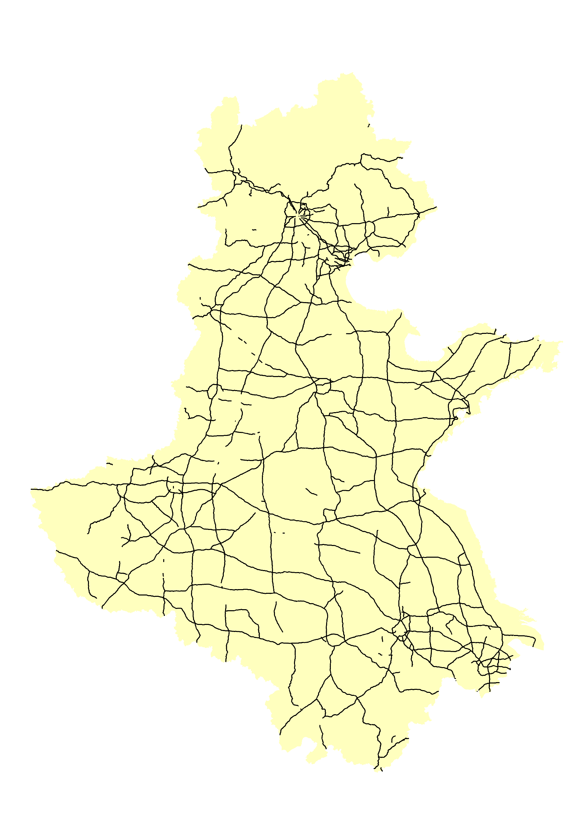
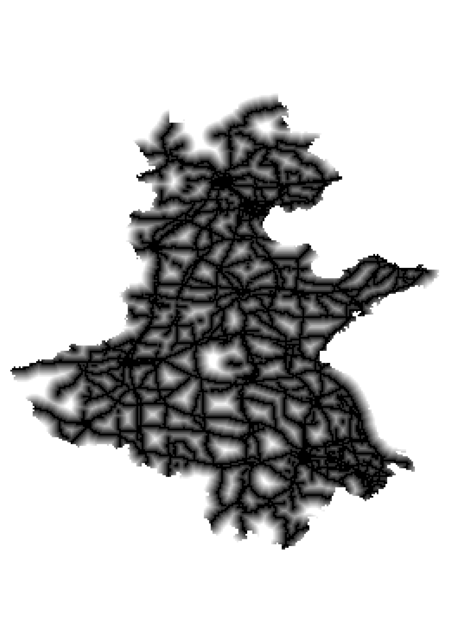


Data preprocessing
Model training
Landsat archive
Urban expansion maps
Training parcels
256
256
Random crop
Training
Concatenation
Expansion prediction
Transition potential
UNET
Roads
Elevation
Distance to Roads
Slope
Pixel allocation
Final prediction

Slide 9
 | Urban | Non-urban
Urban | A | B
Non-urban | C | D

